Slide 1

Final Year Project
---------------------------------------------------TO--------------------------------------------------
Prof. Rajeev Puri
Computer Science Department, D.A.V. College, Jalandhar.
--------------------------------------------------BY--------------------------------------------------
Anurag Kaul(206301) & Himanshi(206313)
BSc IT (Information Technology)
University Roll.no-10572016161, 10572016165
Session(2020-23)

Slide 2
Acknowledgement
Firstly, We would like to thank our computer teacher (Mr. Rajeev Puri), because he always supported and guided us while doing this project. He very well cleared all the doubts we had regarding this project. Also, we would like to especially thank our parents and friends who helped us a lot to complete this project within the limited time.
The journey of making this project has been beautiful, as well as knowledgeable for us and we have learned a lot from it.
Once again, thanks to everyone who was involved with this project from beginning to end.

Slide 3


A Responsive Food and Recipe Web Application

Slide 4
Content
Introduction
Objective
Features
Tools and Technologies
Hardware and Software Requirements

Slide 5

Welcome to tandoorinights a food and recipe website dedicated to bringing you delicious, wholesome meals that you can prepare at home. Our goal is to provide you with a one-stop-shop for all your cooking needs, whether you're looking for quick and easy recipes for weeknight dinners, or impressive showstoppers for special occasions.
At tandoorinights we believe that cooking is one of life's great pleasures, and that everyone can learn to create amazing meals in their own kitchen. That's why we've created a vast library of recipes, from classic comfort foods to exciting new flavor combinations, all carefully tested and adapted for home cooks of all skill levels.
We also believe in using fresh, whole ingredients whenever possible, and in supporting local farmers and producers. So many of our recipes feature seasonal produce, sustainably-raised meats, and other wholesome ingredients that not only taste great, but are good for you and the planet.
Whether you're a seasoned home cook or just starting out, we're confident that you'll find something to inspire you at tandoorinights. So pull up a chair, browse our recipes, and get ready to take your cooking to the next level!
tandoorinights is a place where you can please your soul and tummy with delicious food recepies of all cuisine. And our service is absolutely free. So start exploring now.

Slide 6

Objective
The objective of our tandoorinights web application is to provide a comprehensive and user-friendly platform for people who are passionate about cooking, whether they are beginners or experienced cooks. Our website aims to:
Inspire and educate: We want to inspire our users to get creative in the kitchen and provide them with the tools and resources they need to expand their culinary skills and knowledge.
Empower and engage: We aim to empower our users by providing them with a community of like-minded individuals who share their love of cooking and encourage them to experiment with new recipes and ingredients.
Simplify and streamline: We want to make cooking and meal planning as easy and stress-free as possible by providing users with a variety of recipes, tools, and resources that help them save time and reduce waste.
Provide value: We aim to provide our users with valuable content and resources that help them achieve their cooking and nutrition goals, whether that means eating healthier, cooking on a budget, or trying new cuisines.
Overall, our objective is to create a welcoming and supportive community of food enthusiasts and provide them with the resources and inspiration they need to explore the world of cooking and create delicious meals that they can enjoy and share with their loved ones.

Slide 7

Recipe collection: Our website likely has a large collection of recipes that are carefully curated and tested by our team. These recipes may range from simple, everyday meals to more elaborate dishes for special occasions.
High-quality images: Since food is a visual medium, your website may feature beautiful, high-quality photos of the dishes to entice users to try them.
Nutritional information: If you emphasize using fresh, whole ingredients, your website may provide nutritional information for each recipe to help users make informed choices.
Nutritional information: Many people are interested in the nutritional content of the foods they eat, so our website may provide information on the calories, macronutrients, and micronutrients of each recipe.
Seasonal and local focus: Our website may emphasize the use of seasonal produce and locally-sourced ingredients to promote sustainability and support local food systems.
Blog and cooking tips: In addition to recipes, Our website may feature a blog with cooking tips, ingredient guides, and other helpful resources for home cooks.
Social media integration: Our website may have links to your social media pages where users can follow you for updates on new recipes, behind-the-scenes peeks, and more.
Mobile responsiveness: To accommodate users who access your website from mobile devices, Our website may be optimized for mobile viewing and have a responsive design that adjusts to different screen sizes.

Slide 8

Tools and Technologies
Frontend:
Our food and recipe website uses a variety of tools and technologies to create a modern, responsive, and user-friendly experience for our visitors. On the frontend, we use HTML, CSS, and JavaScript to define the structure, layout, and interactivity of our web pages, as well as the popular React.js library to build reusable UI components and manage state in complex applications.
HTML (Hypertext Markup Language): a markup language that defines the structure of web pages.
CSS (Cascading Style Sheets): a style sheet language that defines the presentation of web pages, including layout, typography, and colors.
Sass (Syntactically Awesome Style Sheets) is a CSS preprocessor that allows developers to write CSS in a more efficient and maintainable way. Sass extends the functionality of CSS by providing features such as variables, nesting, mixins, functions, and more. These features help developers to write CSS code that is more reusable, modular, and easier to read and maintain.
JavaScript: a scripting language that is commonly used to add interactivity and functionality to web pages.
React.js: a popular JavaScript library for building user interfaces, which can be used to create reusable UI components and manage state in complex applications.

Slide 9

Backend:
On the backend, we use Node.js as our runtime environment and rely on the MongoDB database and the Mongoose library to handle data modeling and CRUD operations. To manage file uploads in our web application, we use Multer, a middleware that allows us to upload files, save them to a specific directory, and set restrictions on the uploaded files. This ensures that our users can easily upload and access images for recipes and user profiles.
Node.js: a JavaScript runtime that allows developers to build scalable, server-side applications using JavaScript.
MongoDB: a NoSQL database that uses a document-oriented data model and can handle large volumes of unstructured data.

Slide 10
Other tools and technologies that we have used for our food and recipe website:
Express.js: a Node.js framework for building web applications and APIs.
Git: a version control system that allows developers to track changes to code and collaborate with others more effectively.
Multer: is a middleware for handling file uploads in Node.js. It allows you to upload files and handle them in a convenient way, such as saving them to a specific directory, renaming them, or setting certain restrictions on the uploaded files (e.g., file type, size limit). Multer can be used in conjunction with other Node.js frameworks, such as Express.js, to handle file uploads in web applications.
Mongoose is a Node.js library for working with MongoDB, a popular NoSQL database. Mongoose provides a way to model your data in a way that is easy to work with, by allowing you to define schemas and models that map to your MongoDB collections. This makes it easier to perform CRUD (Create, Read, Update, Delete) operations on your data, as well as other complex queries, such as aggregations and indexes.
By leveraging these tools and technologies, you can build a modern, scalable, and responsive food and recipe website that meets the needs of your users and allows you to deliver high-quality content and features.
By using Multer and Mongoose in your food and recipe website, you can handle file uploads (e.g., user profile pictures, recipe images) and interact with your database in a more efficient and organized way.

Slide 11


Slide 12
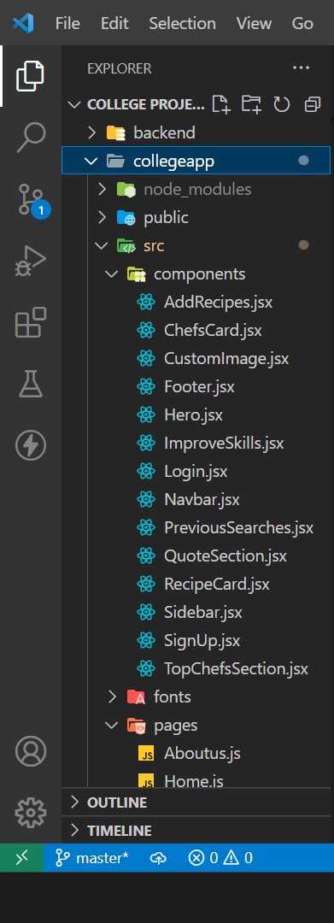
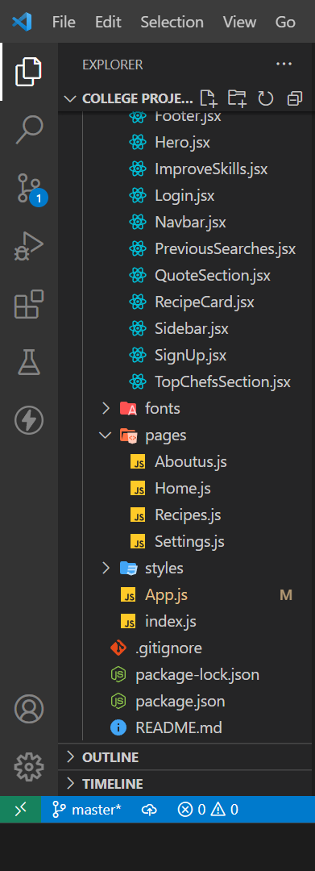
I. Frontend: Our React Application Structure

Slide 13
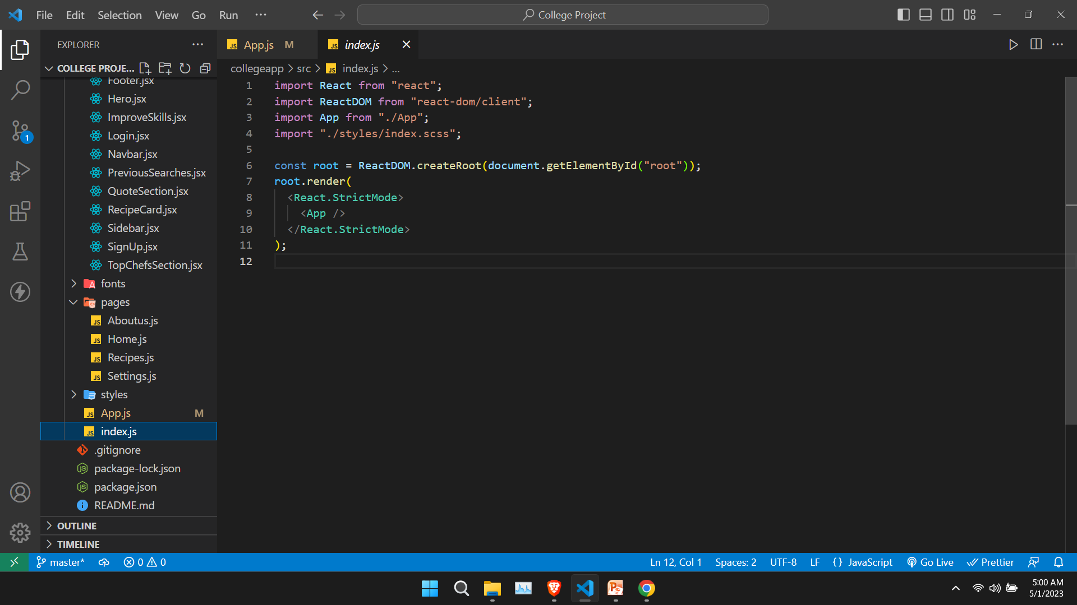
index.js
The index.js file is responsible for setting up the React application and rendering the root component to the HTML DOM using the ReactDOM.render() method. This method takes two arguments: the root component to be rendered and the HTML element where the component should be rendered.
The ReactDOM.render() method renders the <App> component to the root element of the HTML DOM. The <React.StrictMode> component is a built-in component in React that helps highlight potential problems in your application during development.
The index.js file can also include other configuration and setup code for your application, such as importing and configuring external libraries or setting up a service worker for offline support.

Slide 14
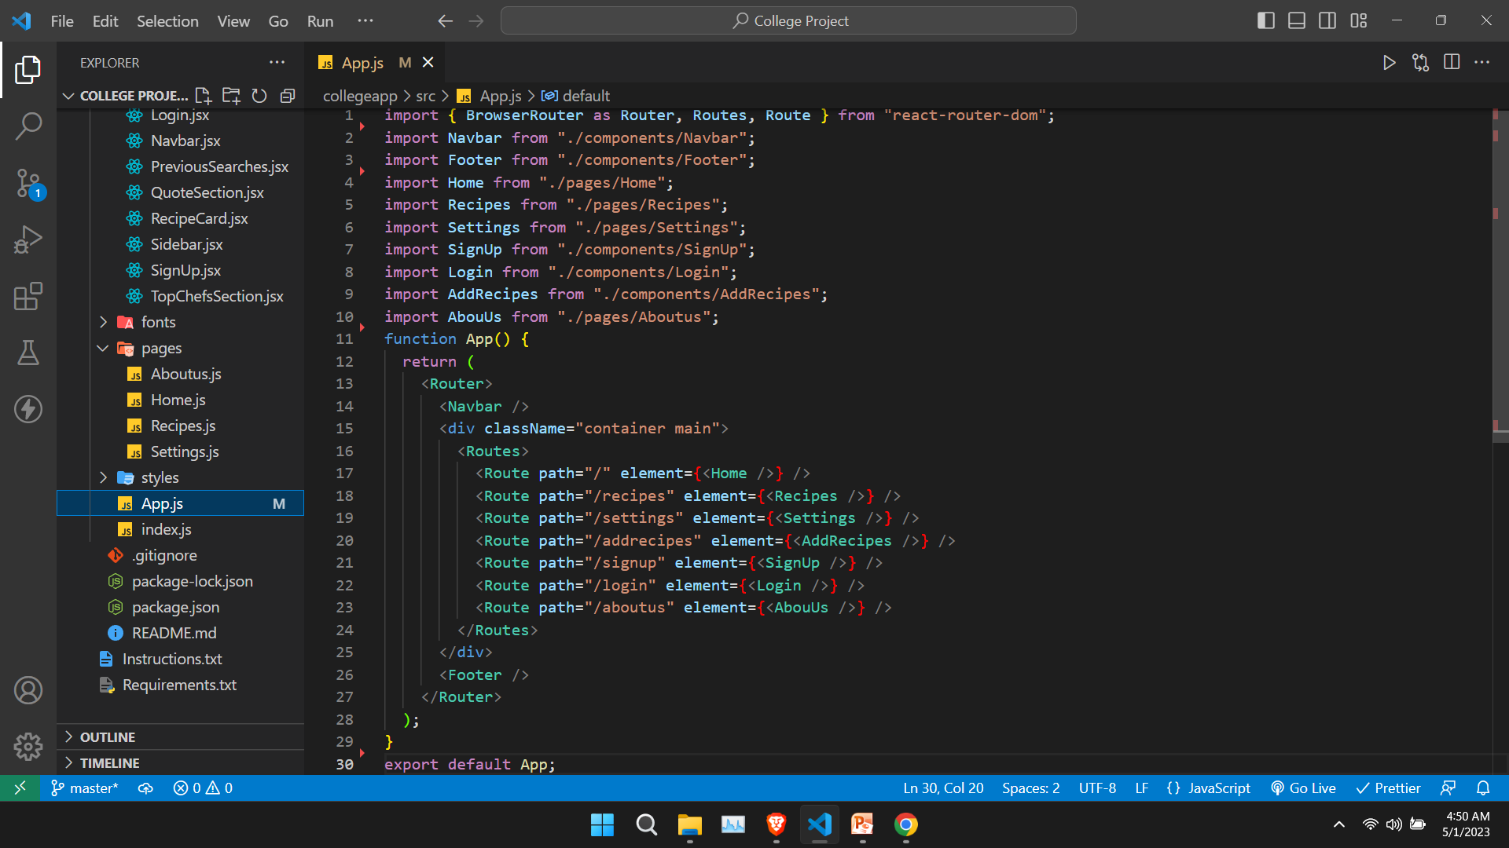
App.js
In React, App.js is a convention for the main entry point of your React application. It typically represents the top-level component of your application and is responsible for rendering all other components that make up the UI.
The App.js file usually contains the main code for configuring your application, such as importing other components, setting up routes, and managing state. It can also contain other helper functions or components that are used throughout your application.

Slide 15
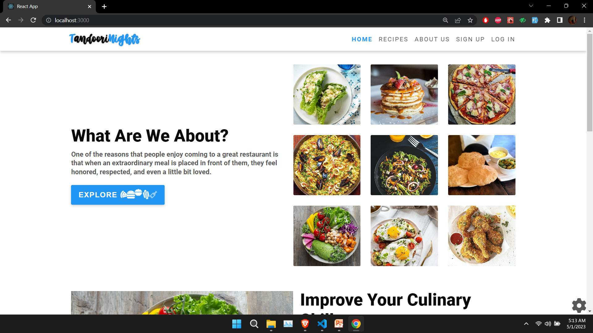
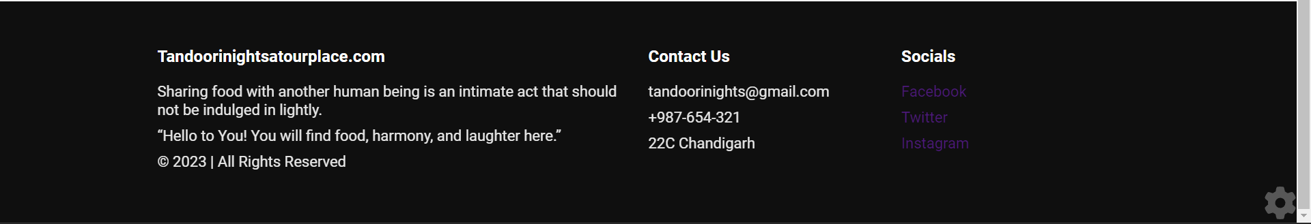
Pages in our Web Application:
In a React application, pages are typically organized as components that represent different views or sections of the user interface. Each page component can be further broken down into smaller, reusable components that represent specific parts of the page's UI.
Home Page(“/”)
Recipes Page(“/recipes”)
About Us Page(“/aboutus”)
Signup Page(“/signup”)
Login Page(“/login”)
Settings Page(“/settings”)
Add Recipes Page(Conditionally rendered, only if the user is logged in) (“/addrecipes”)
Note: Navbar and Footer Component will be rendered in every Page.(See App.js)
<Navbar />
<Footer />

Slide 16

1.Home Page
Home Page React Components
<HeroSection />
<ImproveSkills />
<QuoteSection />
<TopChefsSection />
1.<HeroSection />

Slide 17
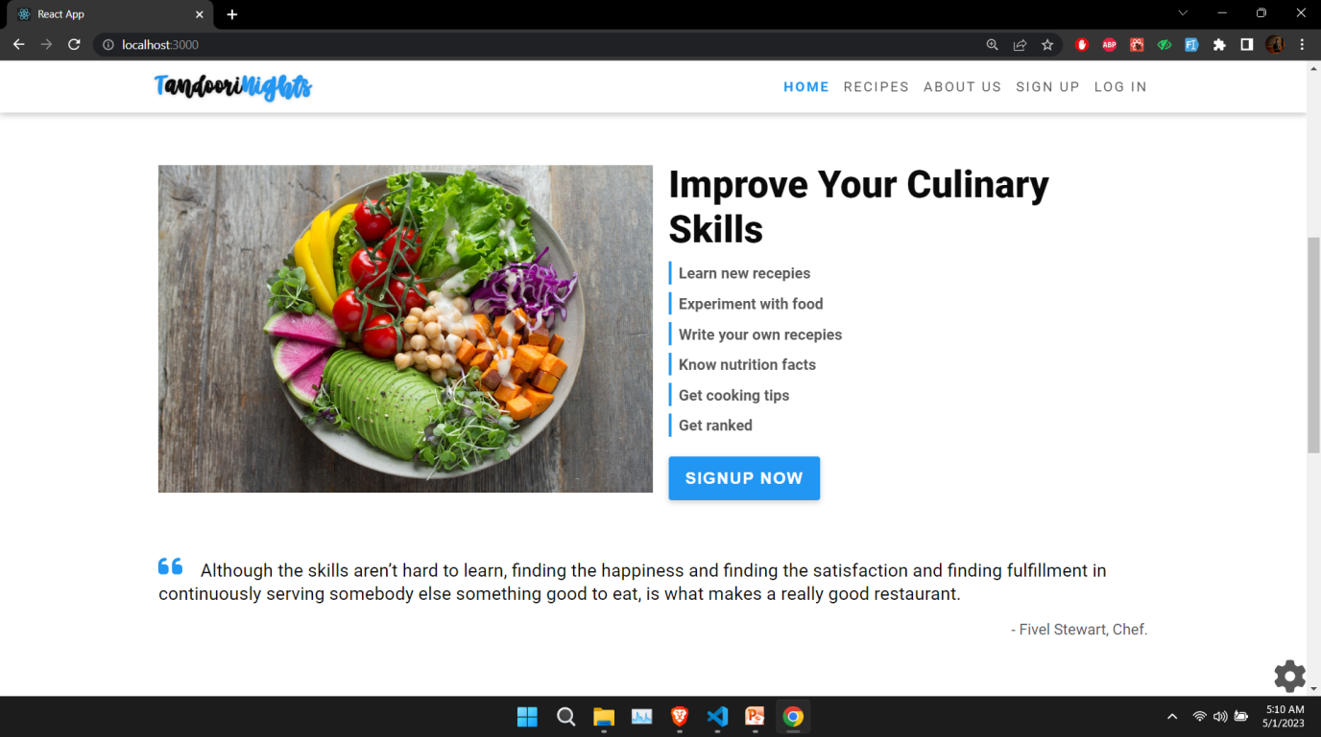
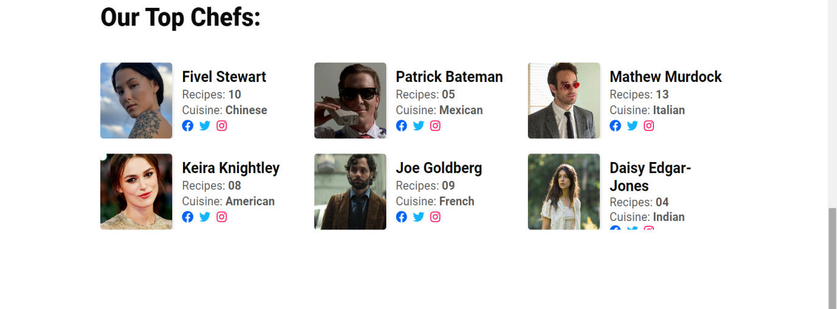
2.<ImproveSkills />
3.<QuoteSection />
4.<TopChefsSection />

Slide 18
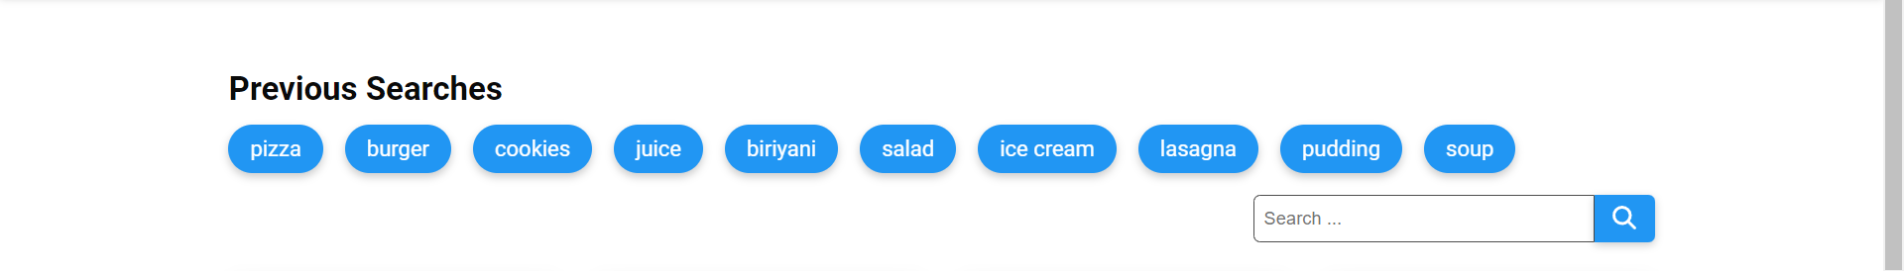
2.Recipes Page
Recipes Page React Components
<PreviousSearches />
<RecipeCard />
1.<PreviousSearches />

Slide 19
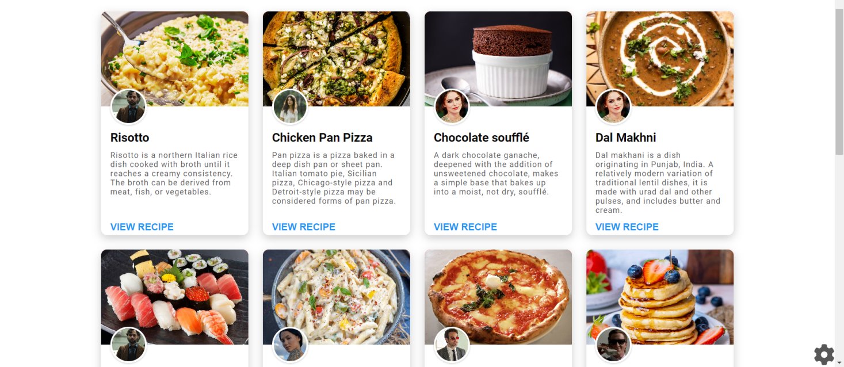
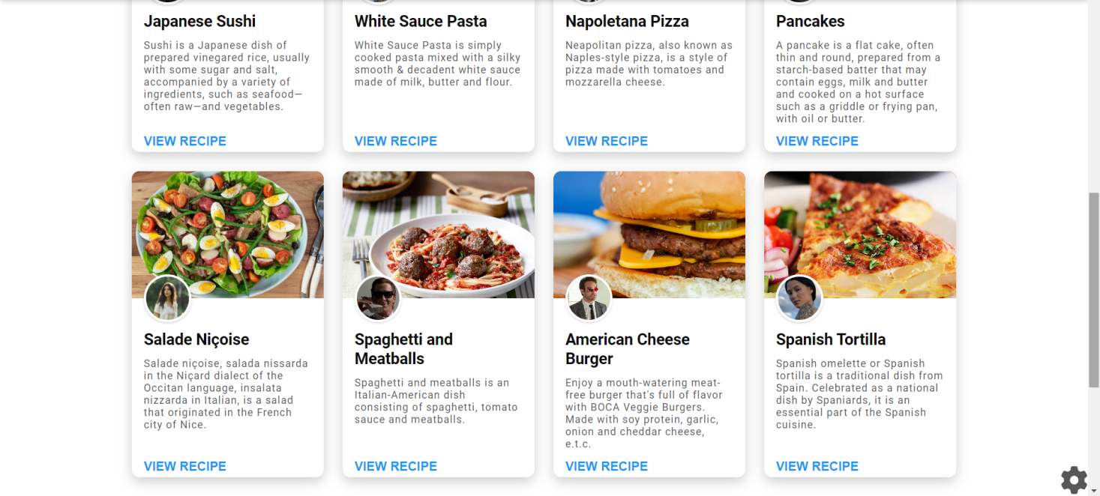
2. <RecipeCard />

Slide 20
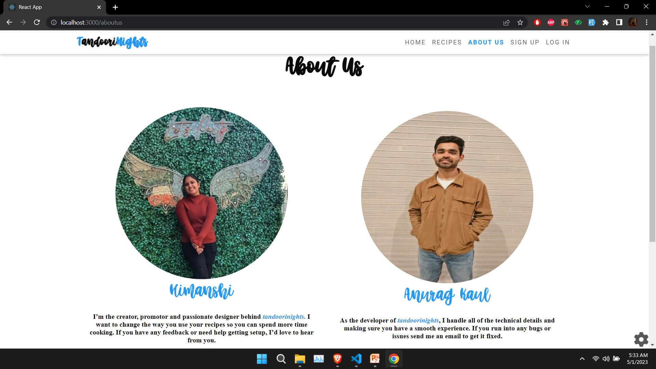
3.About Us Page
About Us Page React Components
<AboutUs />

Slide 21
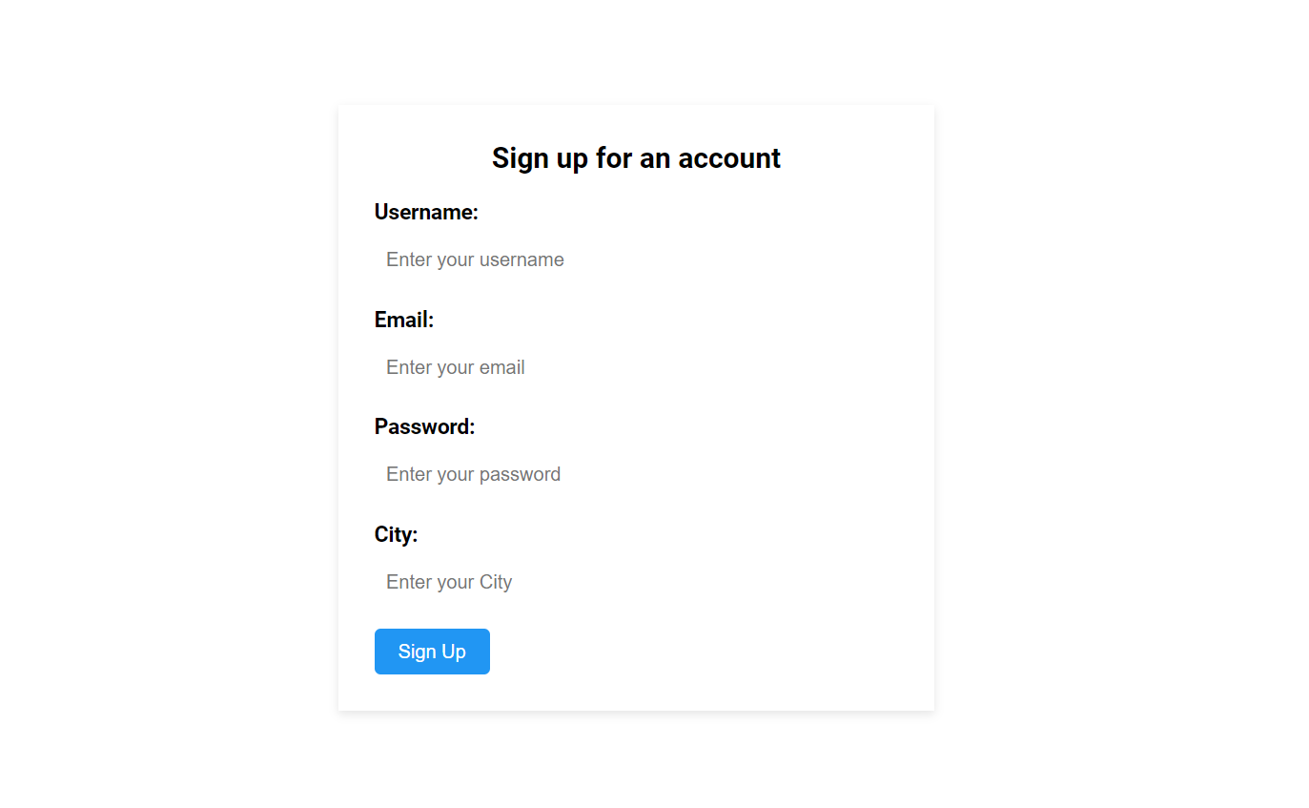
4.Signup Page
Signup Page React Components
<SignUp />

Slide 22
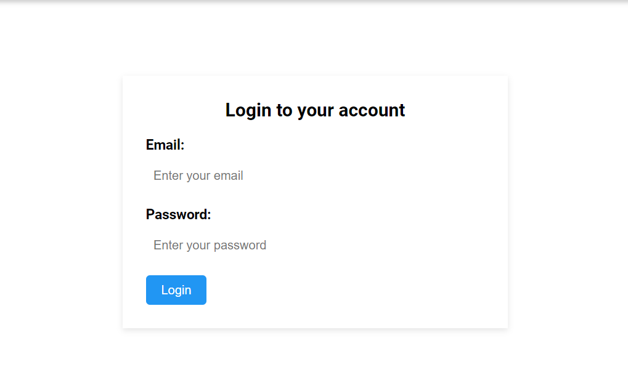
5.Login Page
Login Page React Components
<Login />

Slide 23
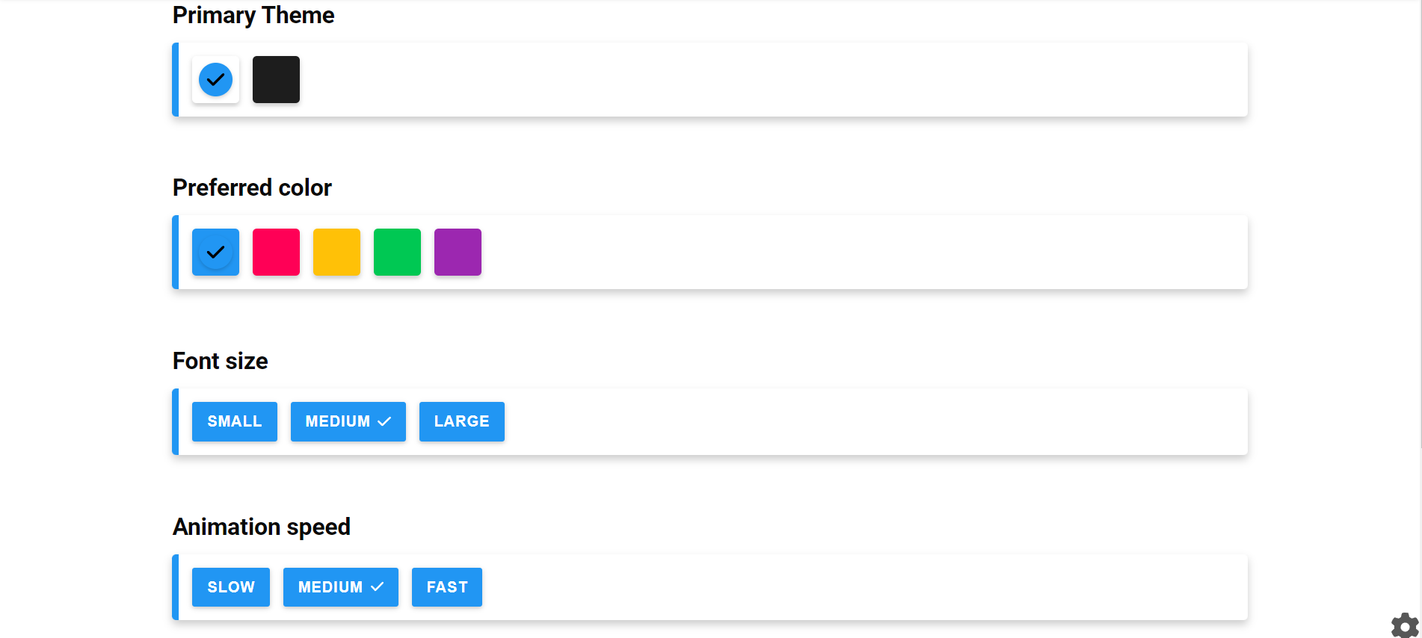
6.Settings Page
Settings Page React Components
<Settings/>

Slide 24
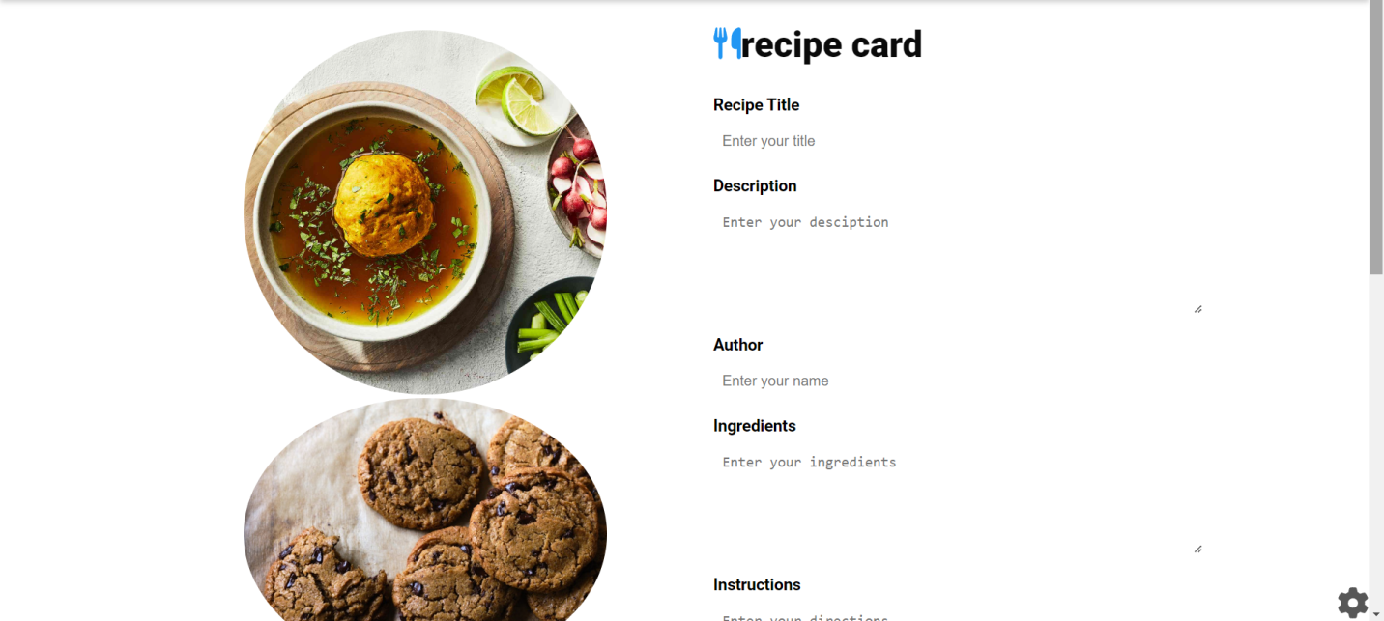
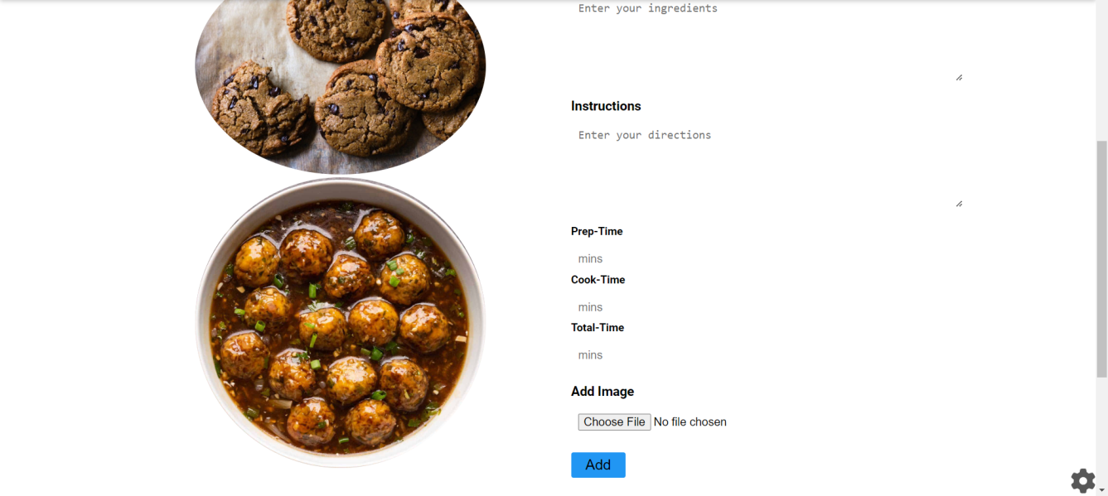

6.Add Recipes Page
Add Recipes Page React Components
<AddRecipes/>

Slide 25
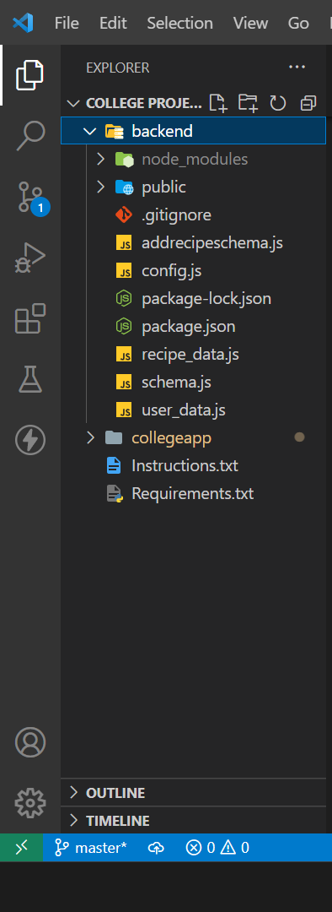
II. Backend:File Structure
We need to run two files from the backend(using node):
user_data.js
recipe_data.js

Slide 26
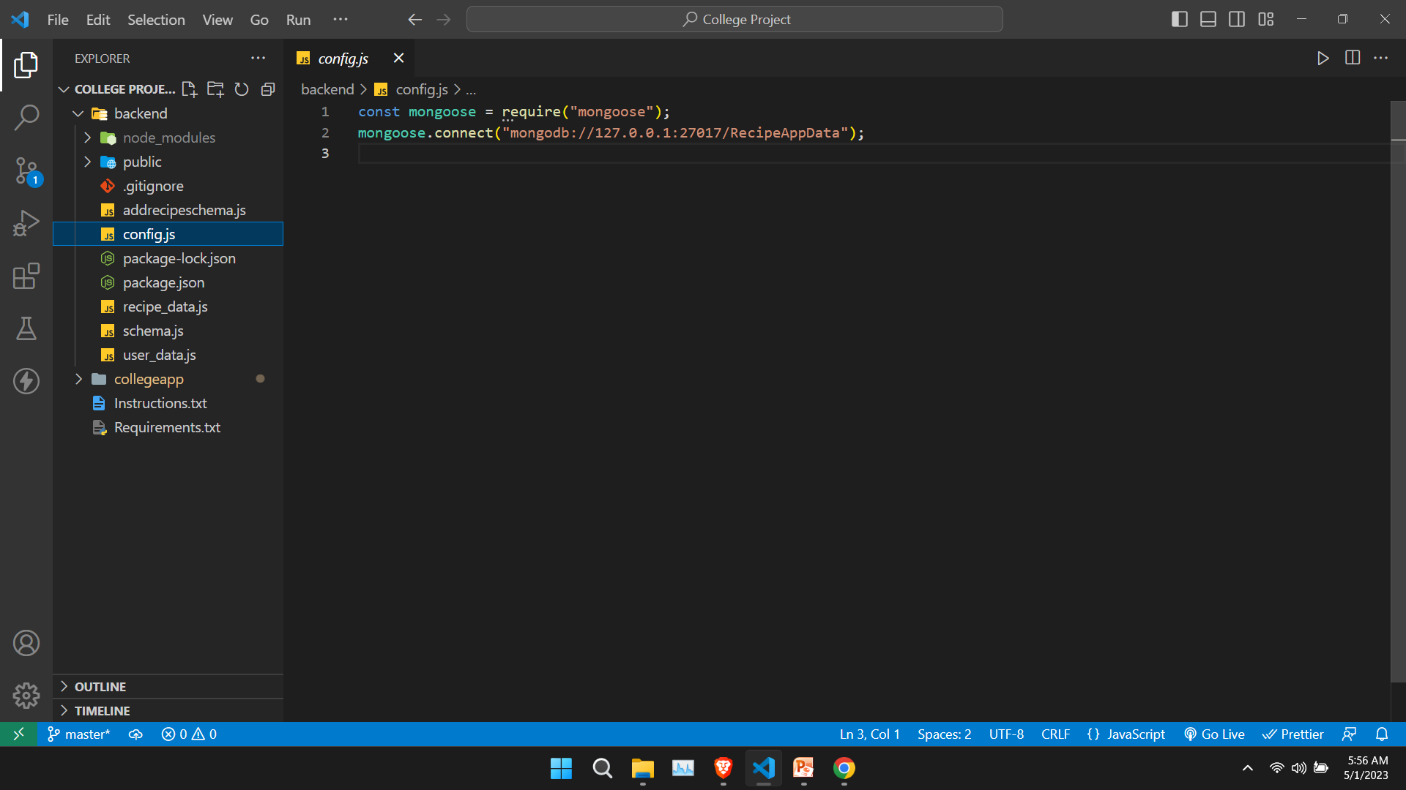
1.config.js- To establish a connection with mongodb.

Slide 27
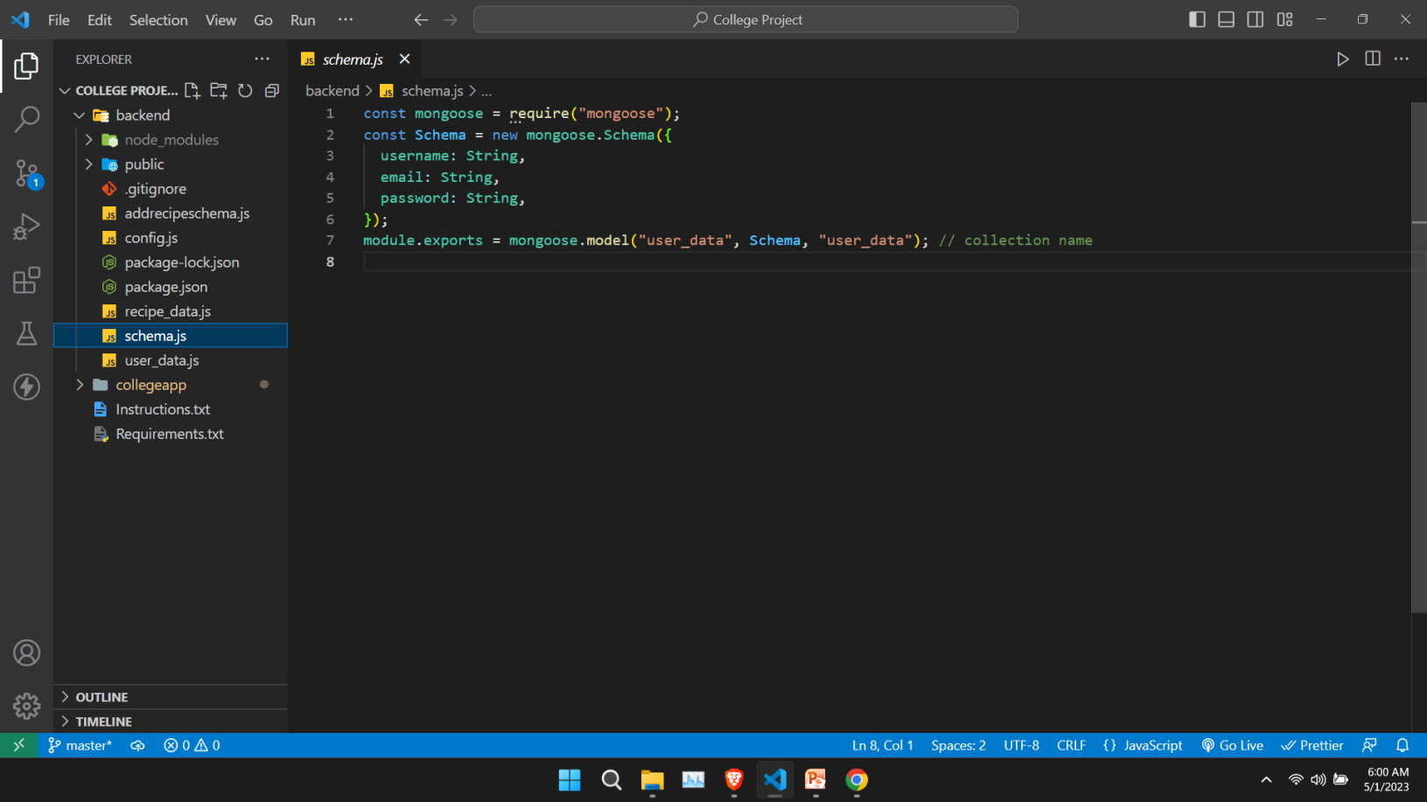
2.shema.js-Schema for /signup data.

Slide 28
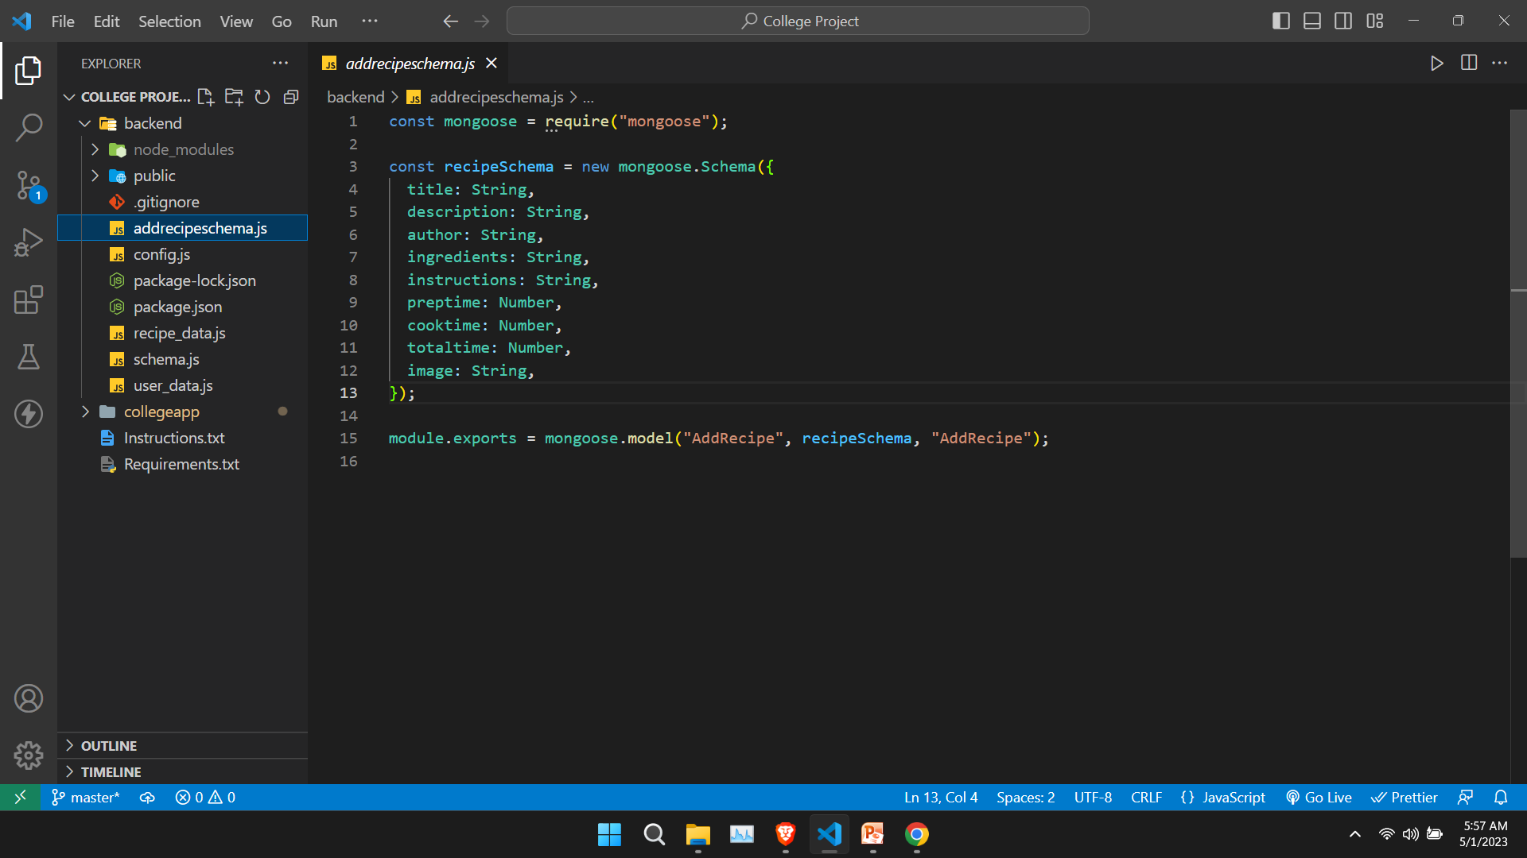
3.addrecipeshema.js-Schema for /addrecipes data.

Slide 29
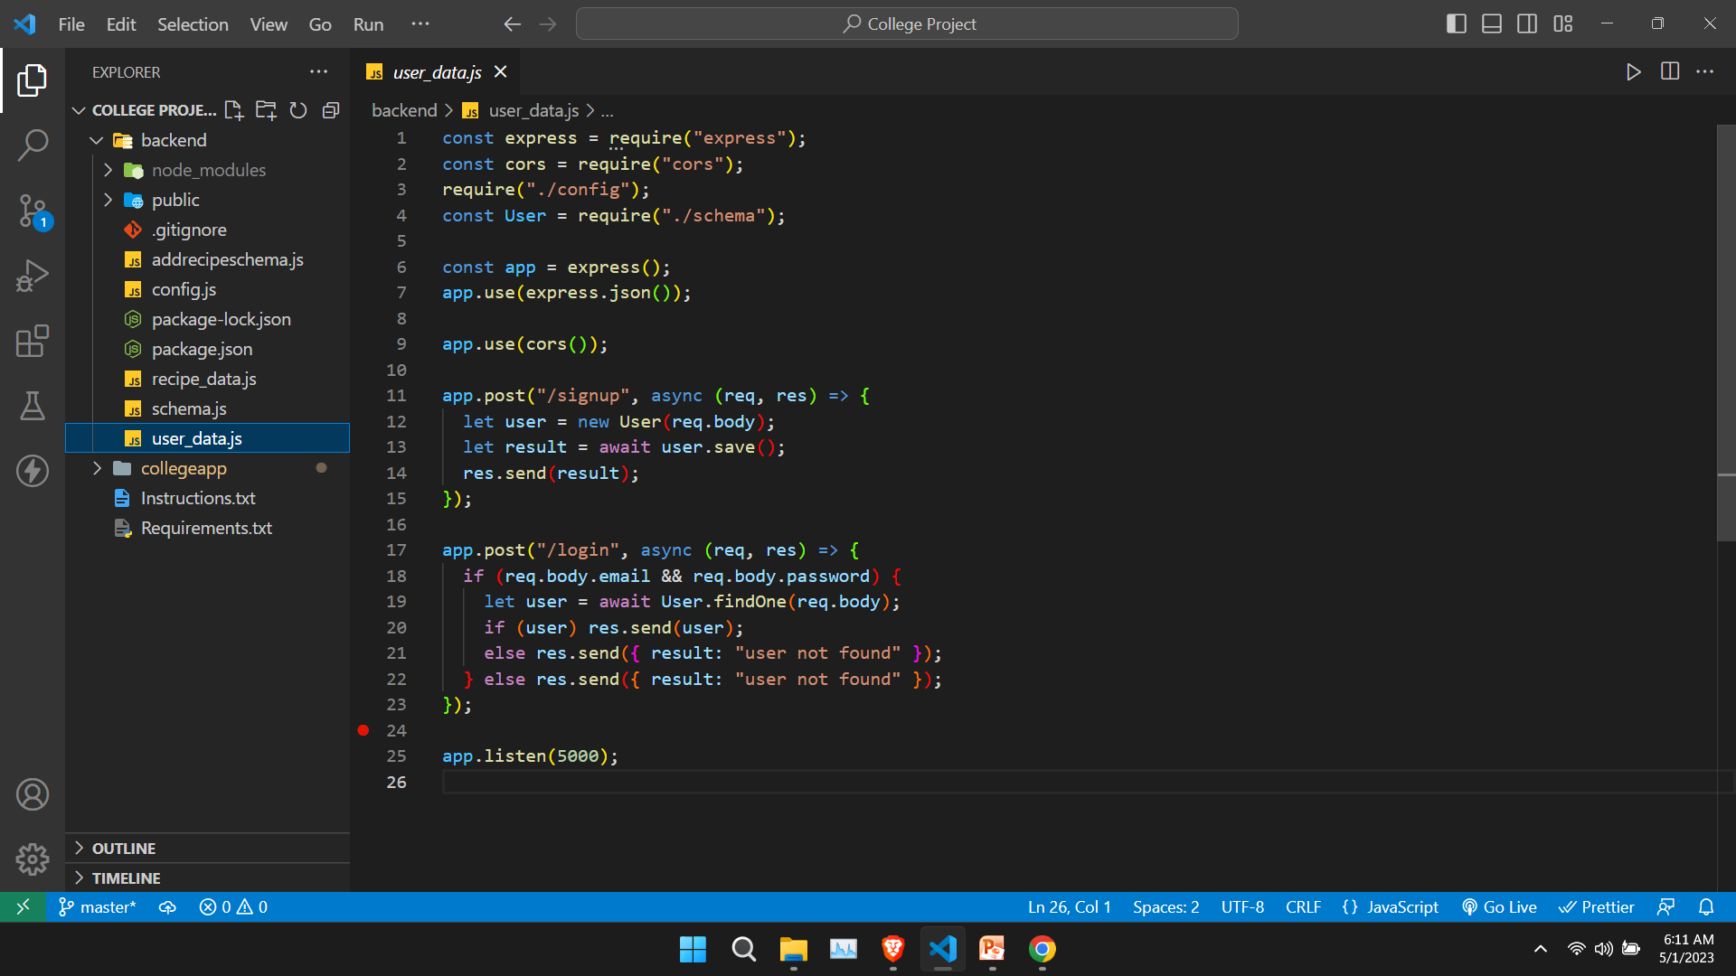
3.user_data.js-To store signup data in mongodb.

Slide 30
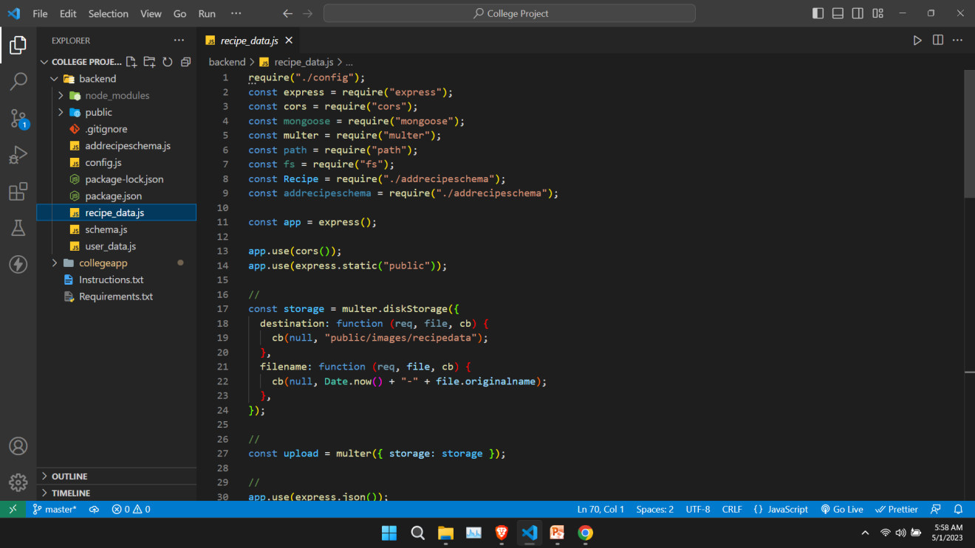
4.recipe_data.js-To store Recipe data in mongodb.
We need to run two files from the backend(cd /backend):
node user_data.js
node recipe_data.js

Slide 31
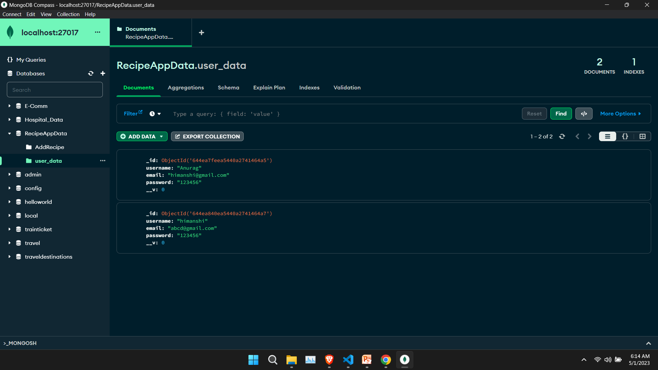
III. Database:mongodb
MongoDB is a popular open-source document-oriented database that is widely used in modern web development. It is designed to store and manage large volumes of data with high performance and scalability, and is known for its flexibility and ease of use.
MongoDB uses a flexible document data model that allows you to store data in a variety of structures, including nested arrays and objects. This makes it well-suited for storing data in a way that reflects the structure of your application, and can help simplify data modeling and improve performance.
Name of the db: RecipeAppData
Collection Name: user_data (user_data will store the /signup data).

Slide 32
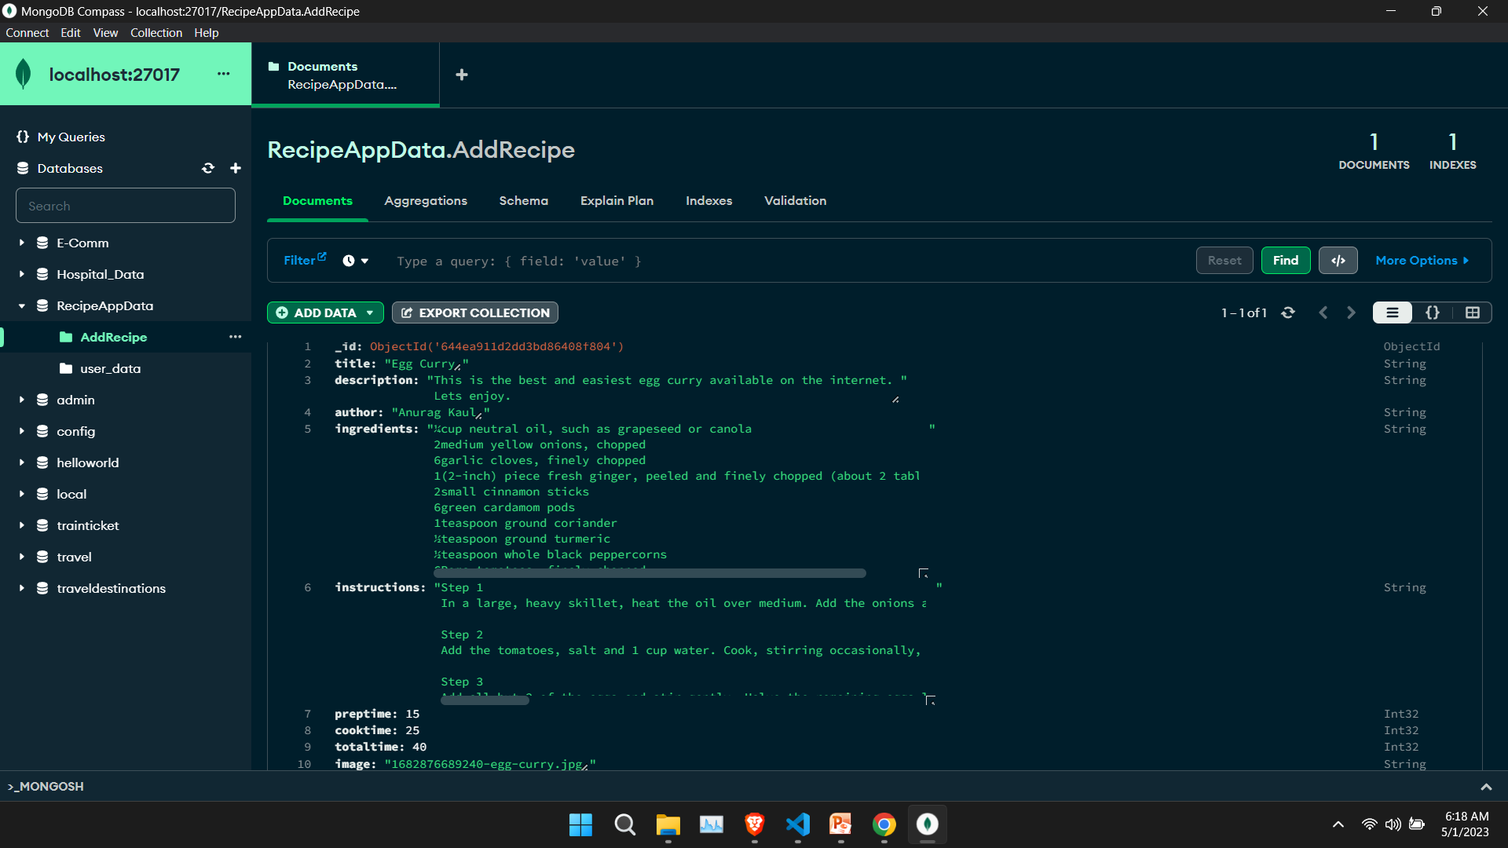
Name of the db: RecipeAppData
Collection Name: AddRecipe (AddRecipe will store the /addrecipes data).

Slide 33
Hardware and Sofware Requirements:
1. Hardware Requirements:
Processor: Intel i3 6th gen (minimum)
RAM :2 GB or above
Hard disk :40 GB or above
2. Software Requirements:
Microsoft Visual Studio Code
Node js
Mongodb and mongodb compass
Languages used : Front-end: HTML, CSS, SASS, Javascript and React js
Back-end: Node js
DATABASE: mongodb

Slide 34


